Slide 1
How to Applique

Slide 2
Jodie Marburger
www.beaumitchellboutique.com

Slide 3
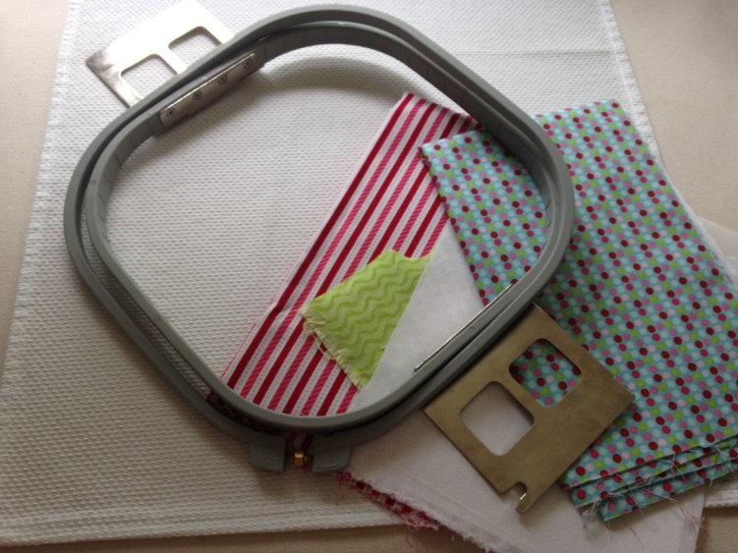
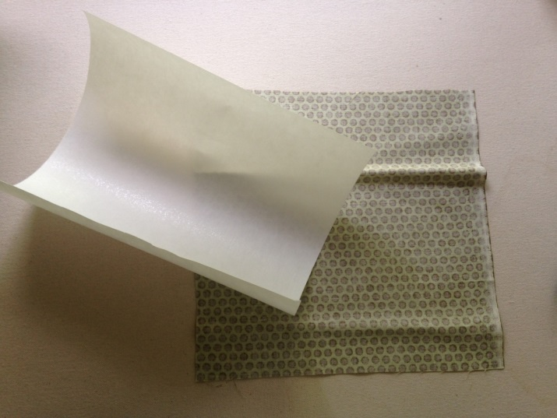
Steps of Applique
Gather your items (garment, fabric, Heat & bond lite, scissors, Iron, hoop)
Cut fabric square and your Heat & Bond Lite slightly smaller than your fabric.

Slide 4
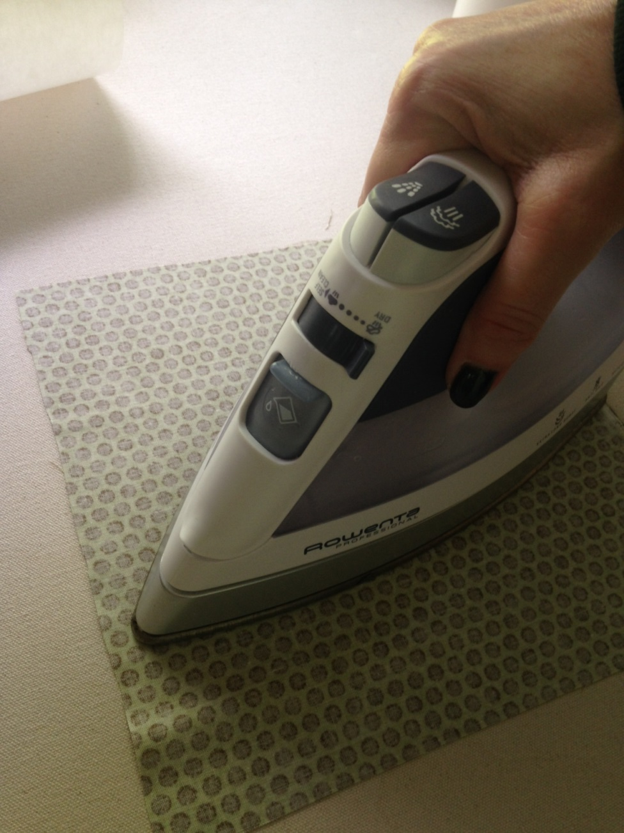
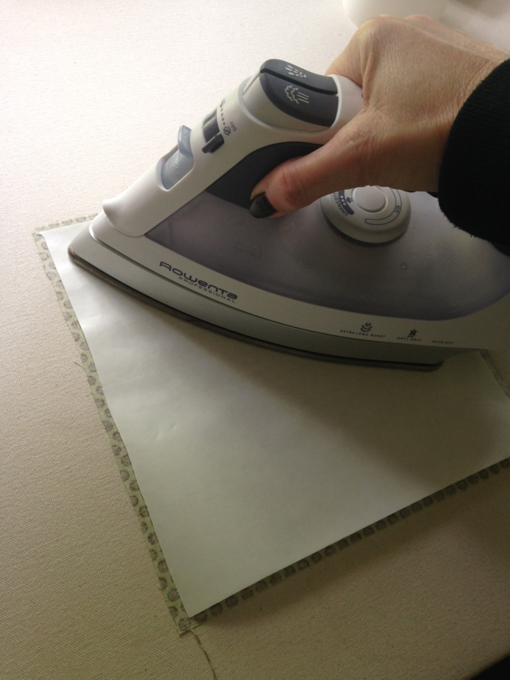
Iron the back of your fabric on the dry cotton setting of your iron(no steam). Add Heat & Bond lite to fabric- shiny side down & until completely adhered to fabric- use no steam, only a dry iron setting.

Slide 5
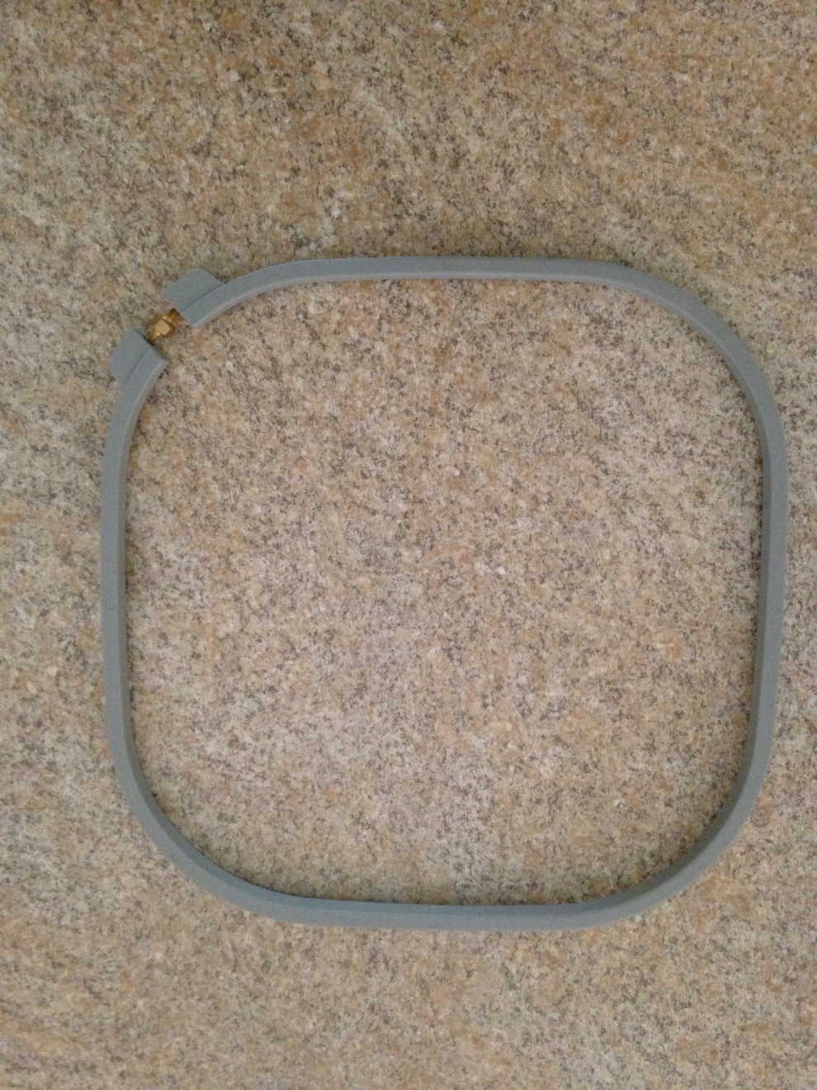
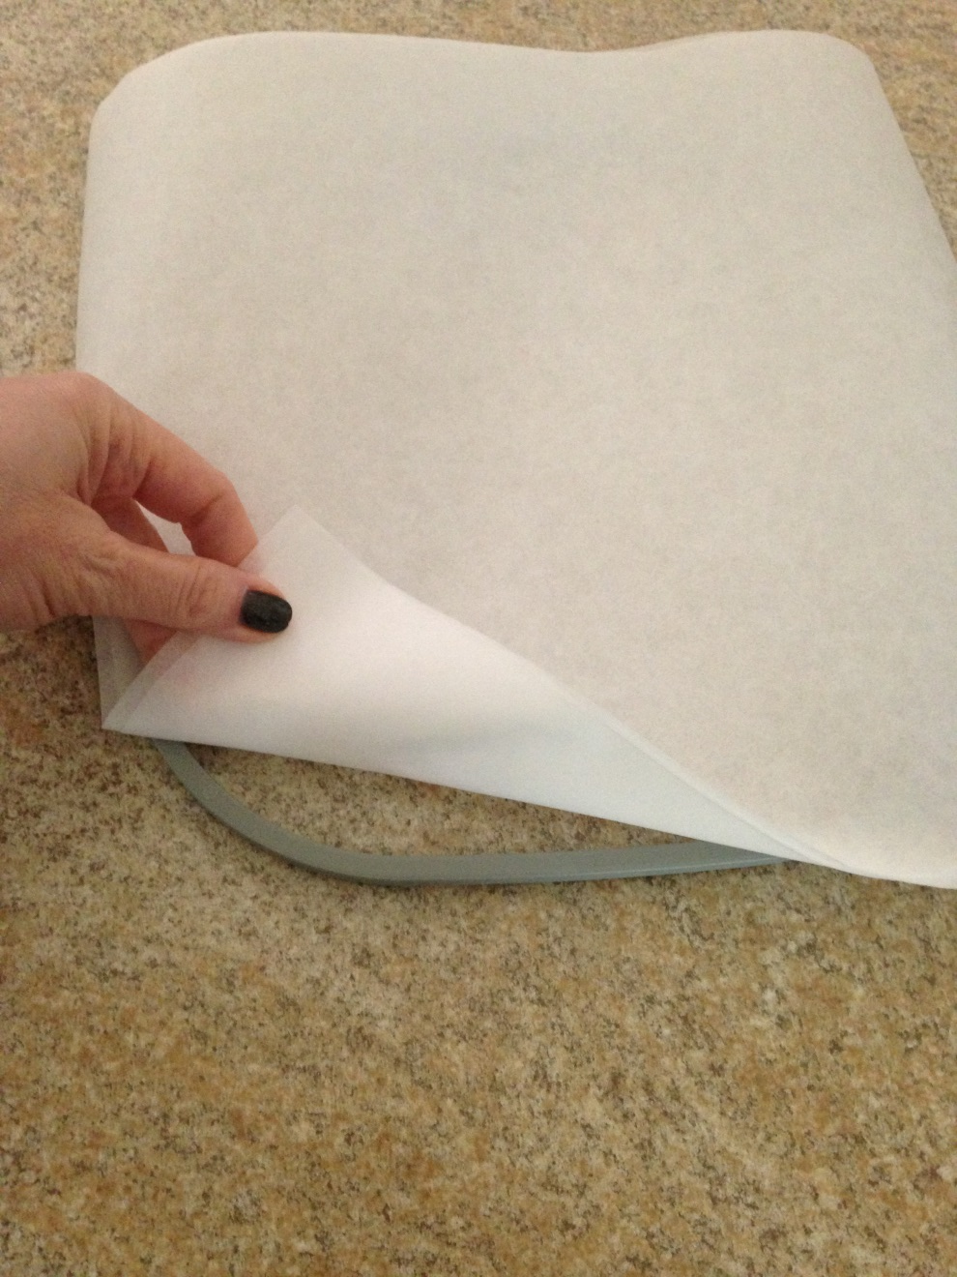
Place hoop on your surface, place stabilizer on top of hoop.

Slide 6
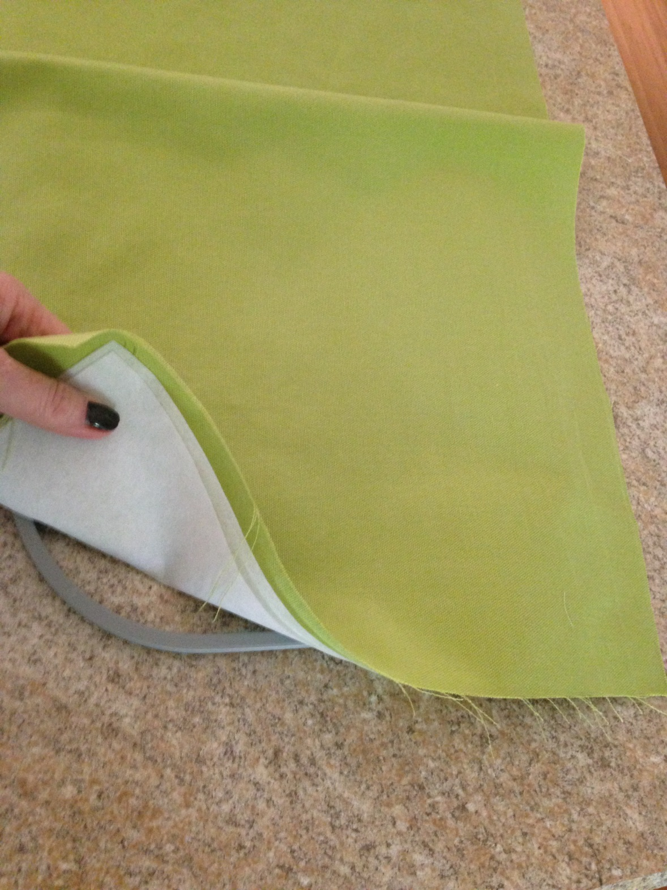
Place garment
on top of
both stabilizer and
hoop bottom.

Slide 7
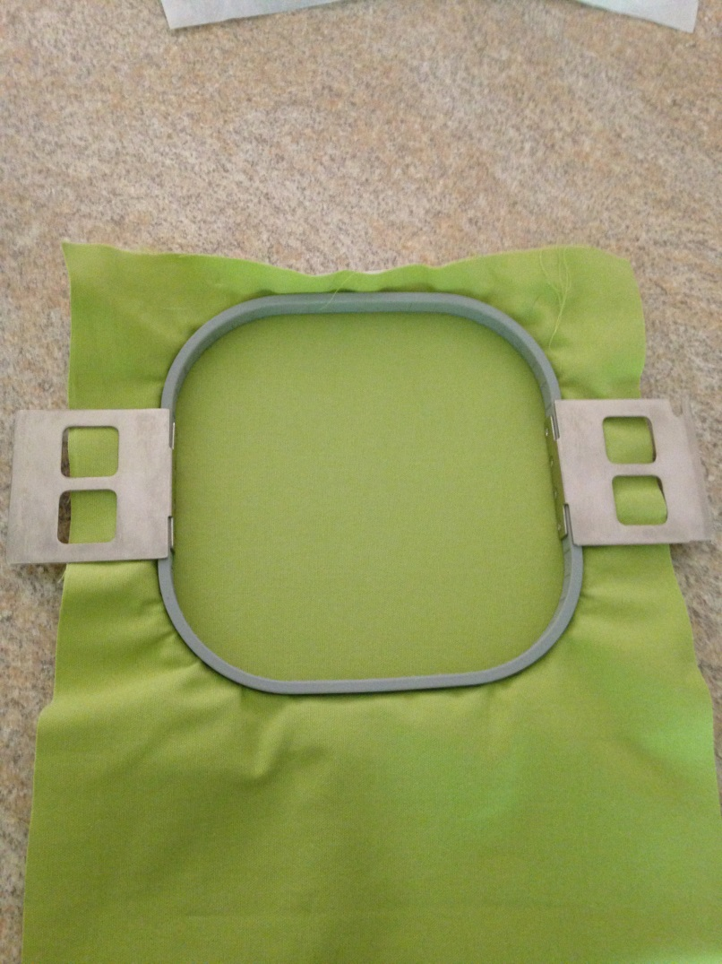
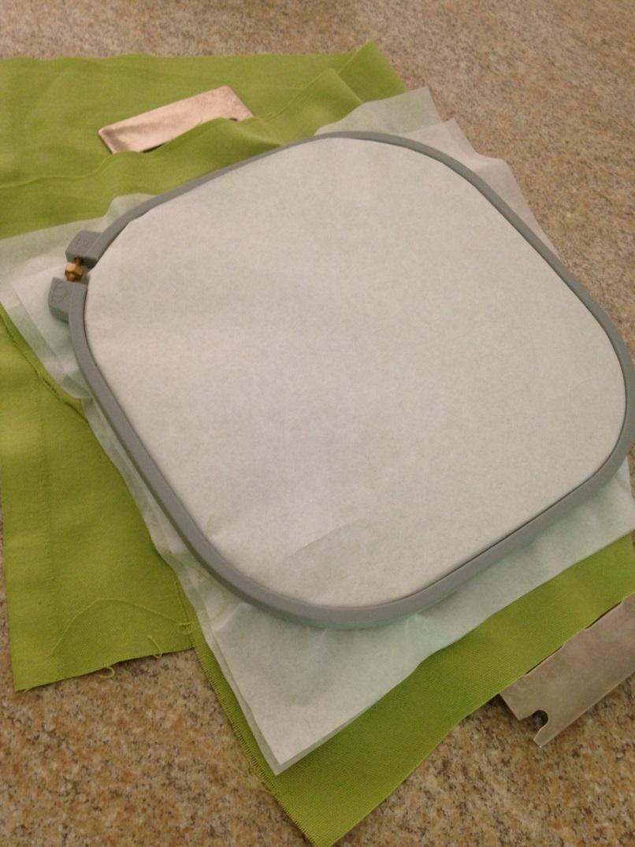
Place hoop top(with the arms for the machine) on the top and push hoop top into place securing all layers in the hoop. Make sure the surface is wrinkle free and tight like a drum (front and back)
FRONT
BACK

Slide 8
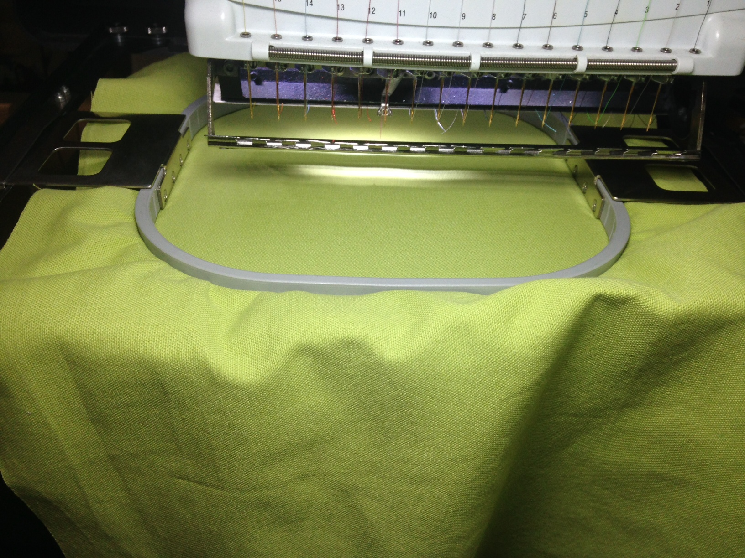
Now your hoop is ready for the machine & to begin the applique process.

Slide 9
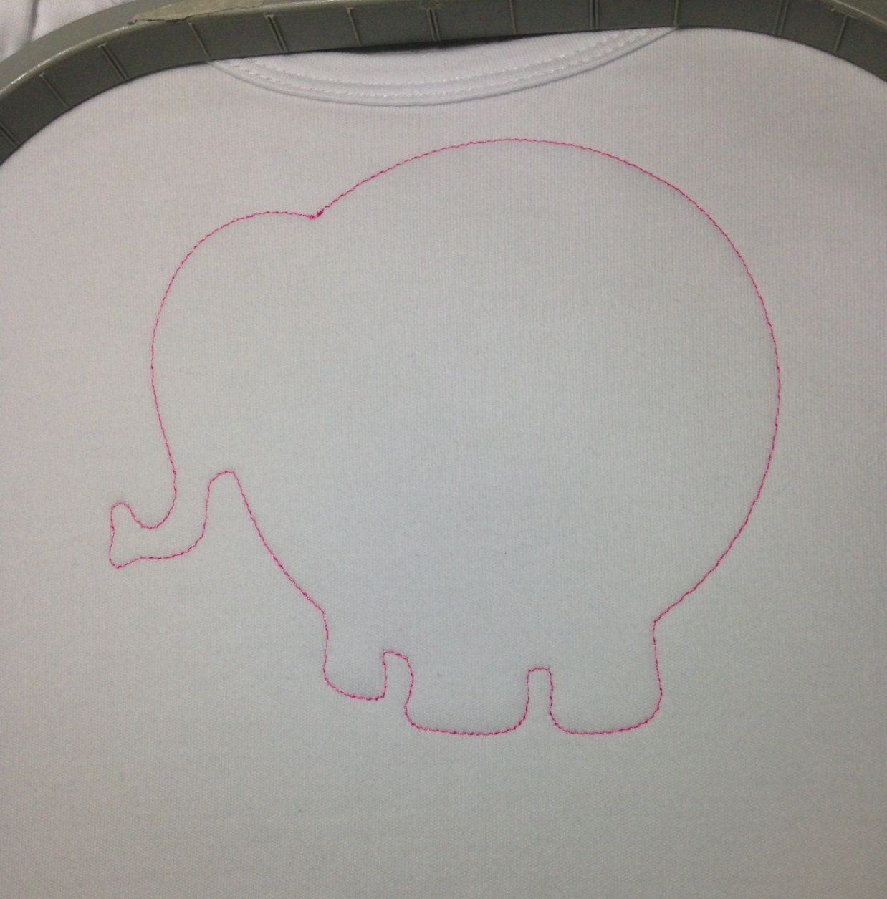
Begin by running your first placement stitches. Stop the machine when finished.

Slide 10
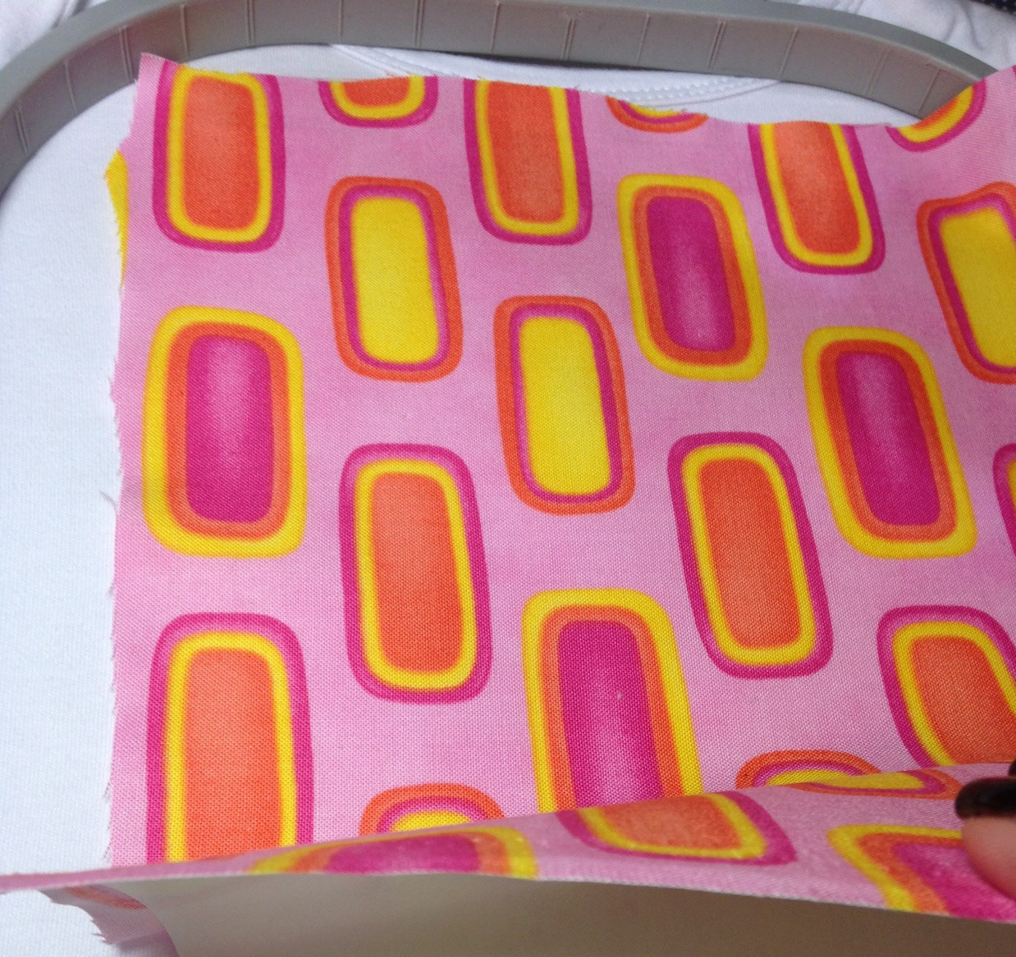
Now place the applique fabric on the garment, covering the placement stitches completely by the fabric.

Slide 11
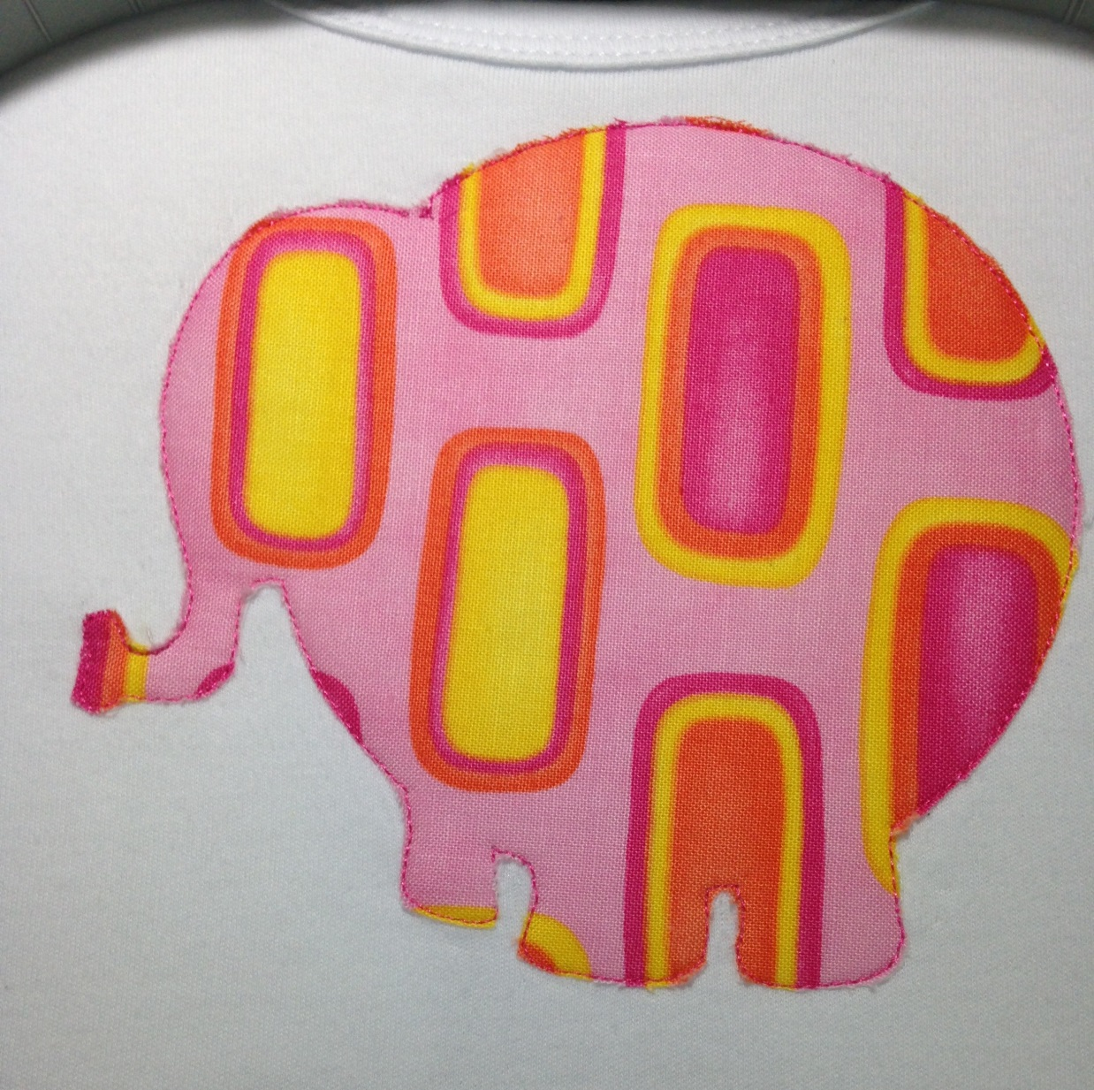
Remove hoop from machine and cut around the applique tack down stitches as close as you can, but do not cut the stitches. Also be careful not to cut garment. Do this for each applique piece.

